Slide 1
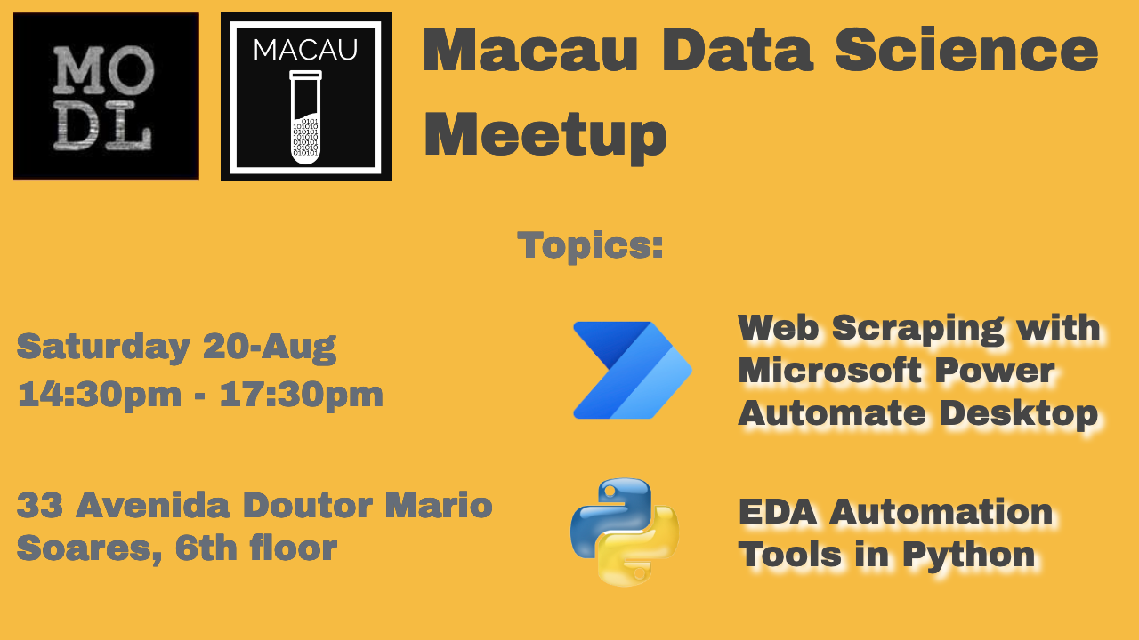

Slide 2
Web Scraping with Microsoft Power Automate Desktop
Adam Zheng

Slide 3
What if..
You have a problem to be solved by creating a service
Base on actions to combine application A and B
You just have no interest to code or reinventing the wheel
However, part of the work is repetitive and boring

Slide 4
Problem for draw a new car plate
For each new vehicle in Macau, plate is draw from 1 of 400 numbers
Numbers lies within range from AA-43-xx to AA-53-xx
Some number is not preferred in Feng Shui, for example number 4
Each day there are new car plate registration, some for bid
Seek for a way to monitor how unlikely getting bad numbers
Thus, pick a best date to draw the plate (科學地迷信)

Slide 5
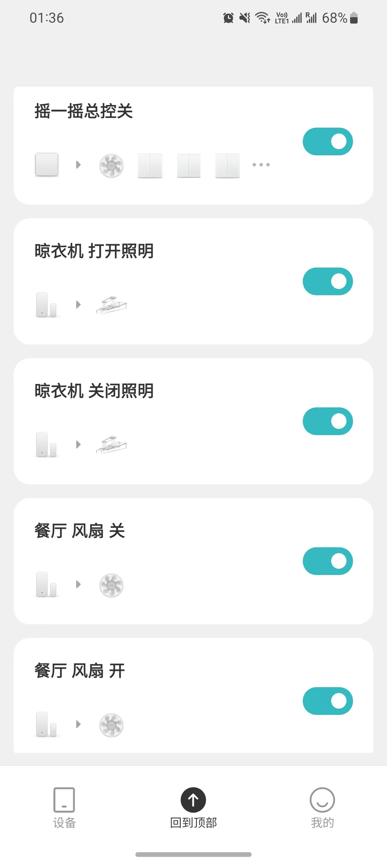
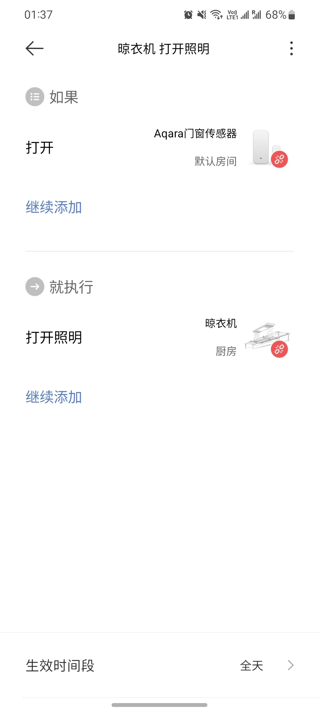
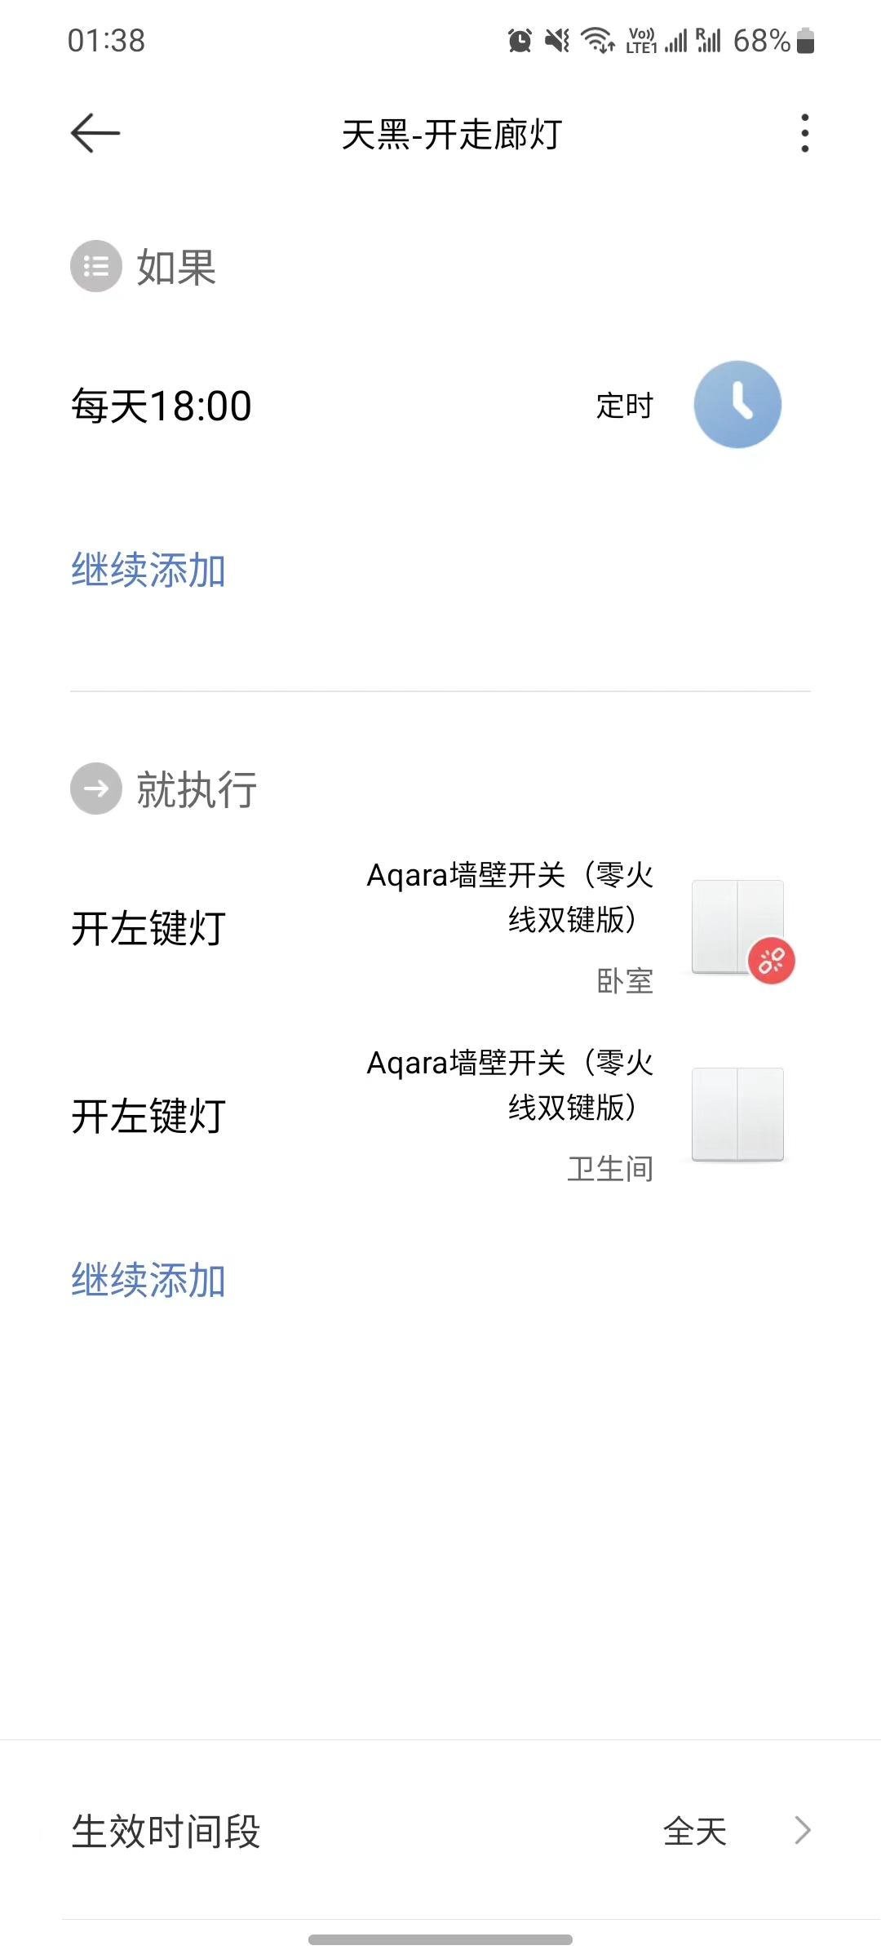
Mijia Scenes (Rule based intelligent)

Slide 6
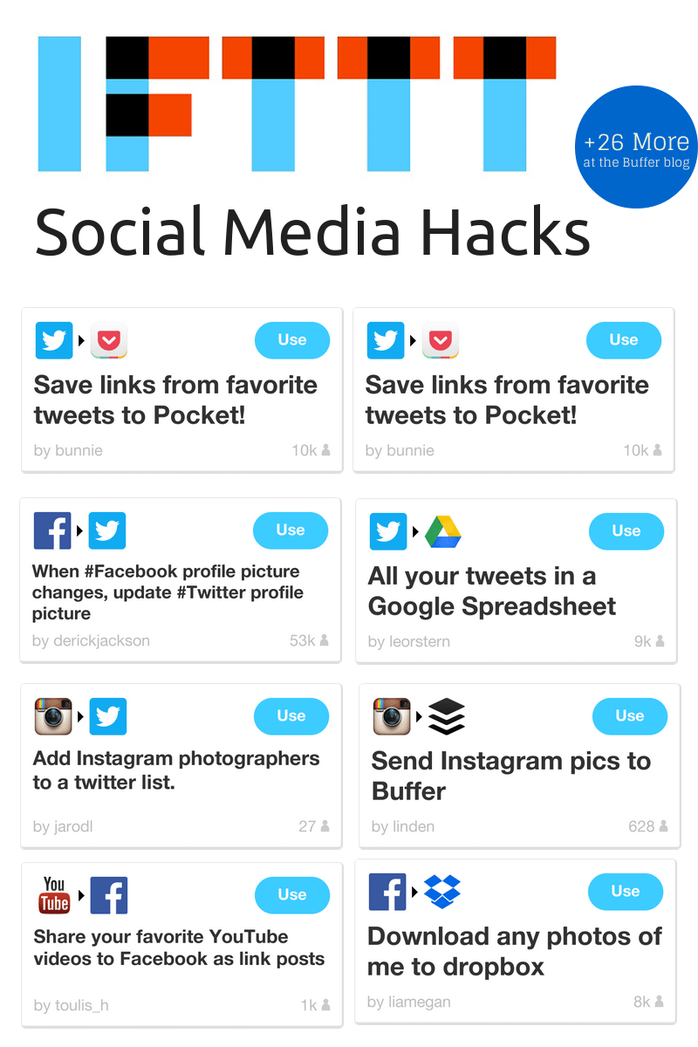
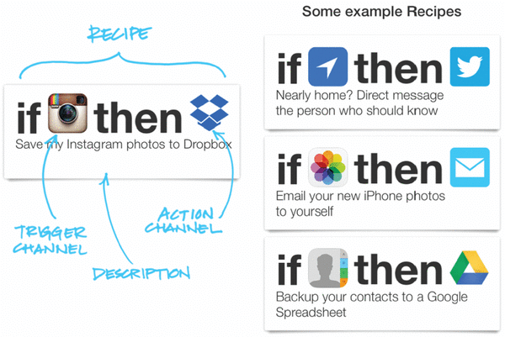
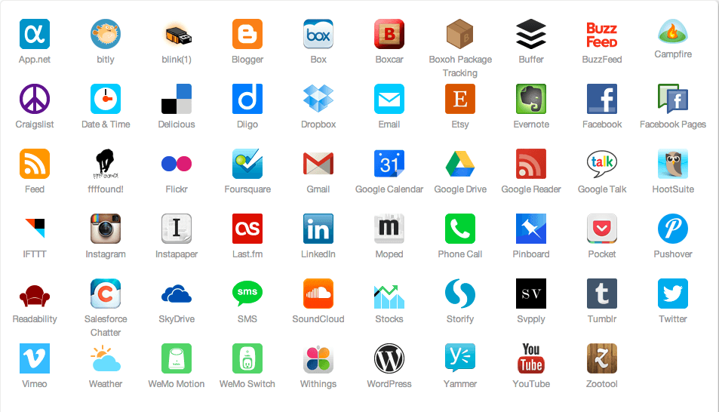
IFTTT (Connectors)
Notes:
Since 2012

Slide 7
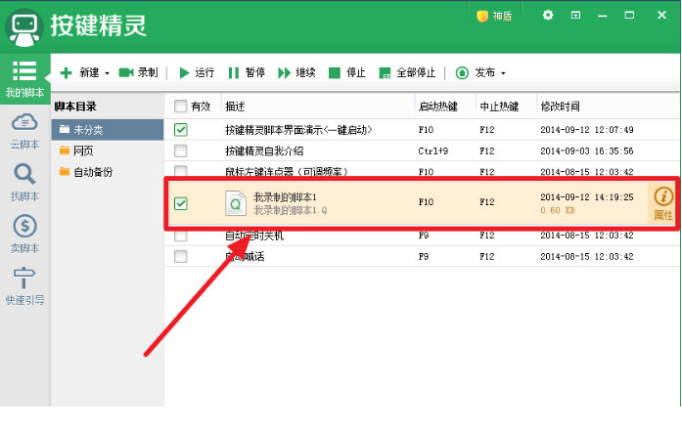
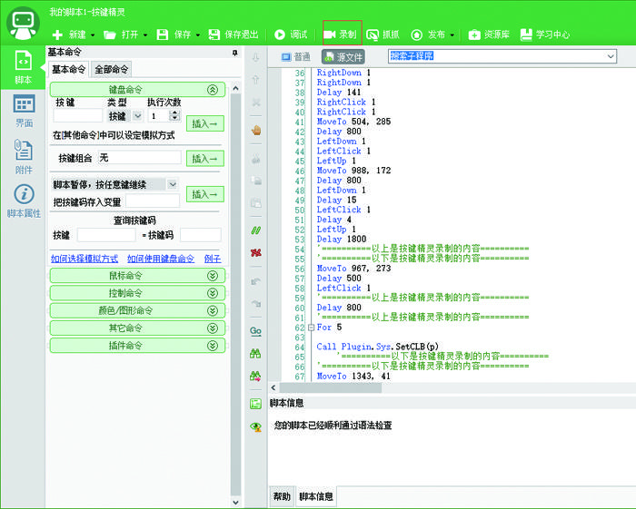
QuickMacro (Macro Recorder)
Record of UI actions into script
Edit for rule conditions
Set for loops
Notes:
Since 2001

Slide 8
RPA Robotic Process Automation
Low code
Concurrency
As a Service
Intelligent (Rule based)
Plentiful Connectors

Slide 9
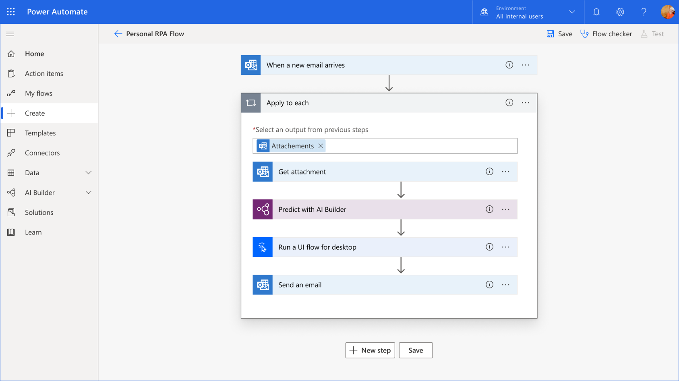
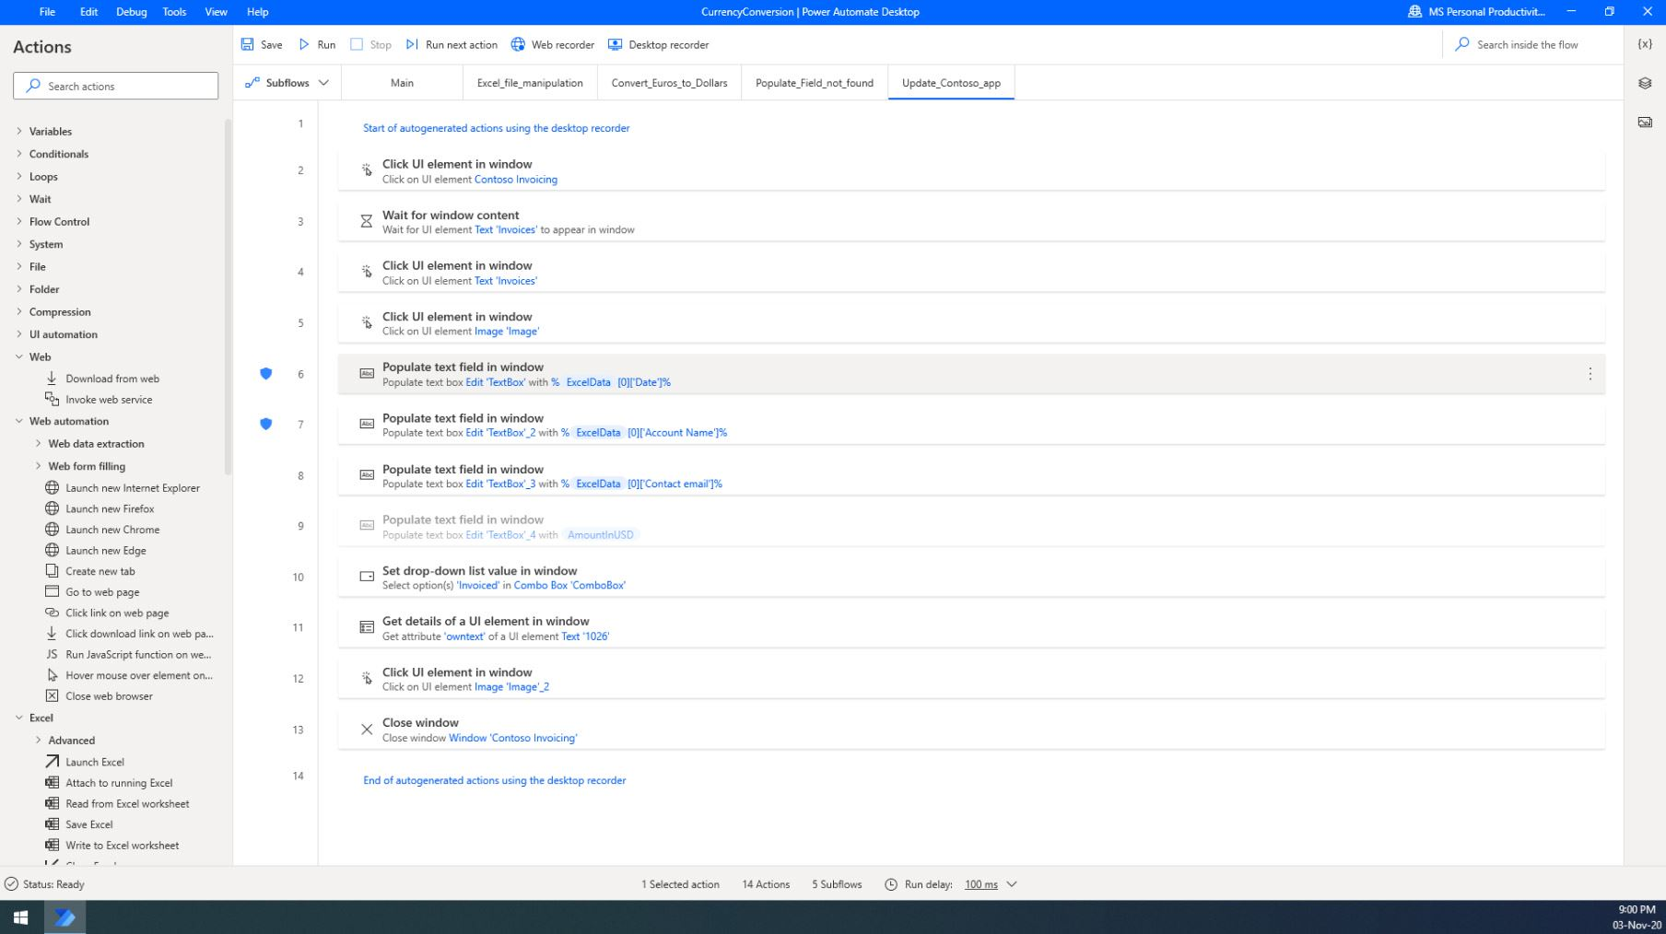




Power Automate / Power Automate Desktop

Slide 10
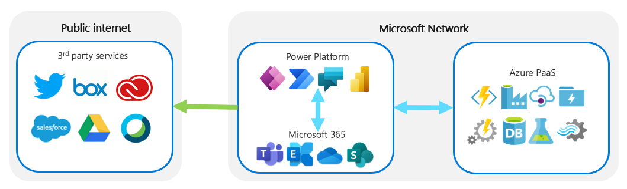
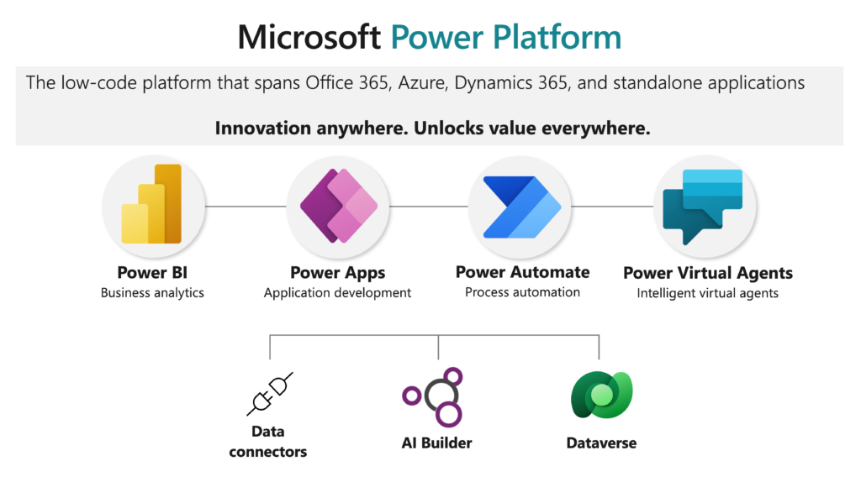
Power Platform
Microsoft Learn: Power Platform
Notes:
Consumer Levels – Windows 365, Microsoft 365 (Office 365)
Enterprise Levels – Windows 365, Microsoft 365, Power Platform, Azure, Dynamic 365

Slide 11
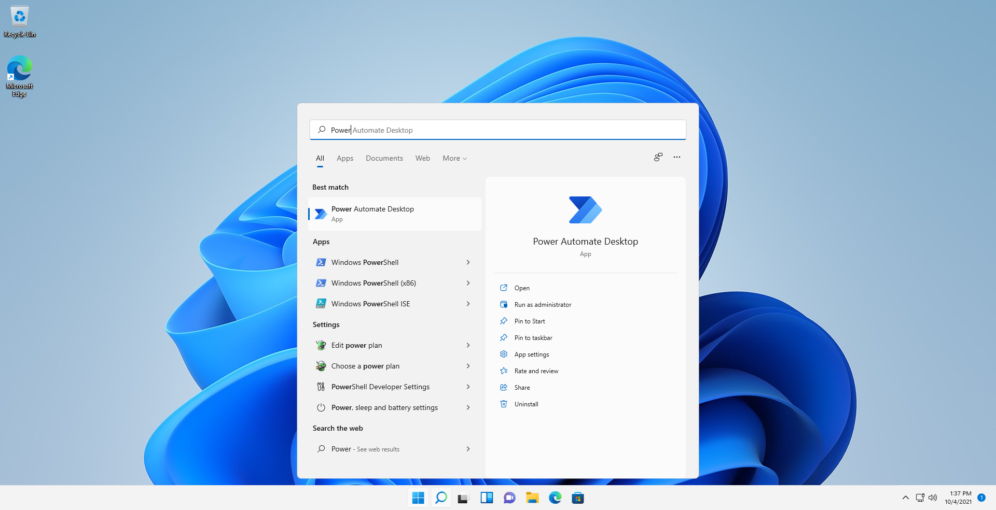
PAD comes in Windows 11

Slide 12
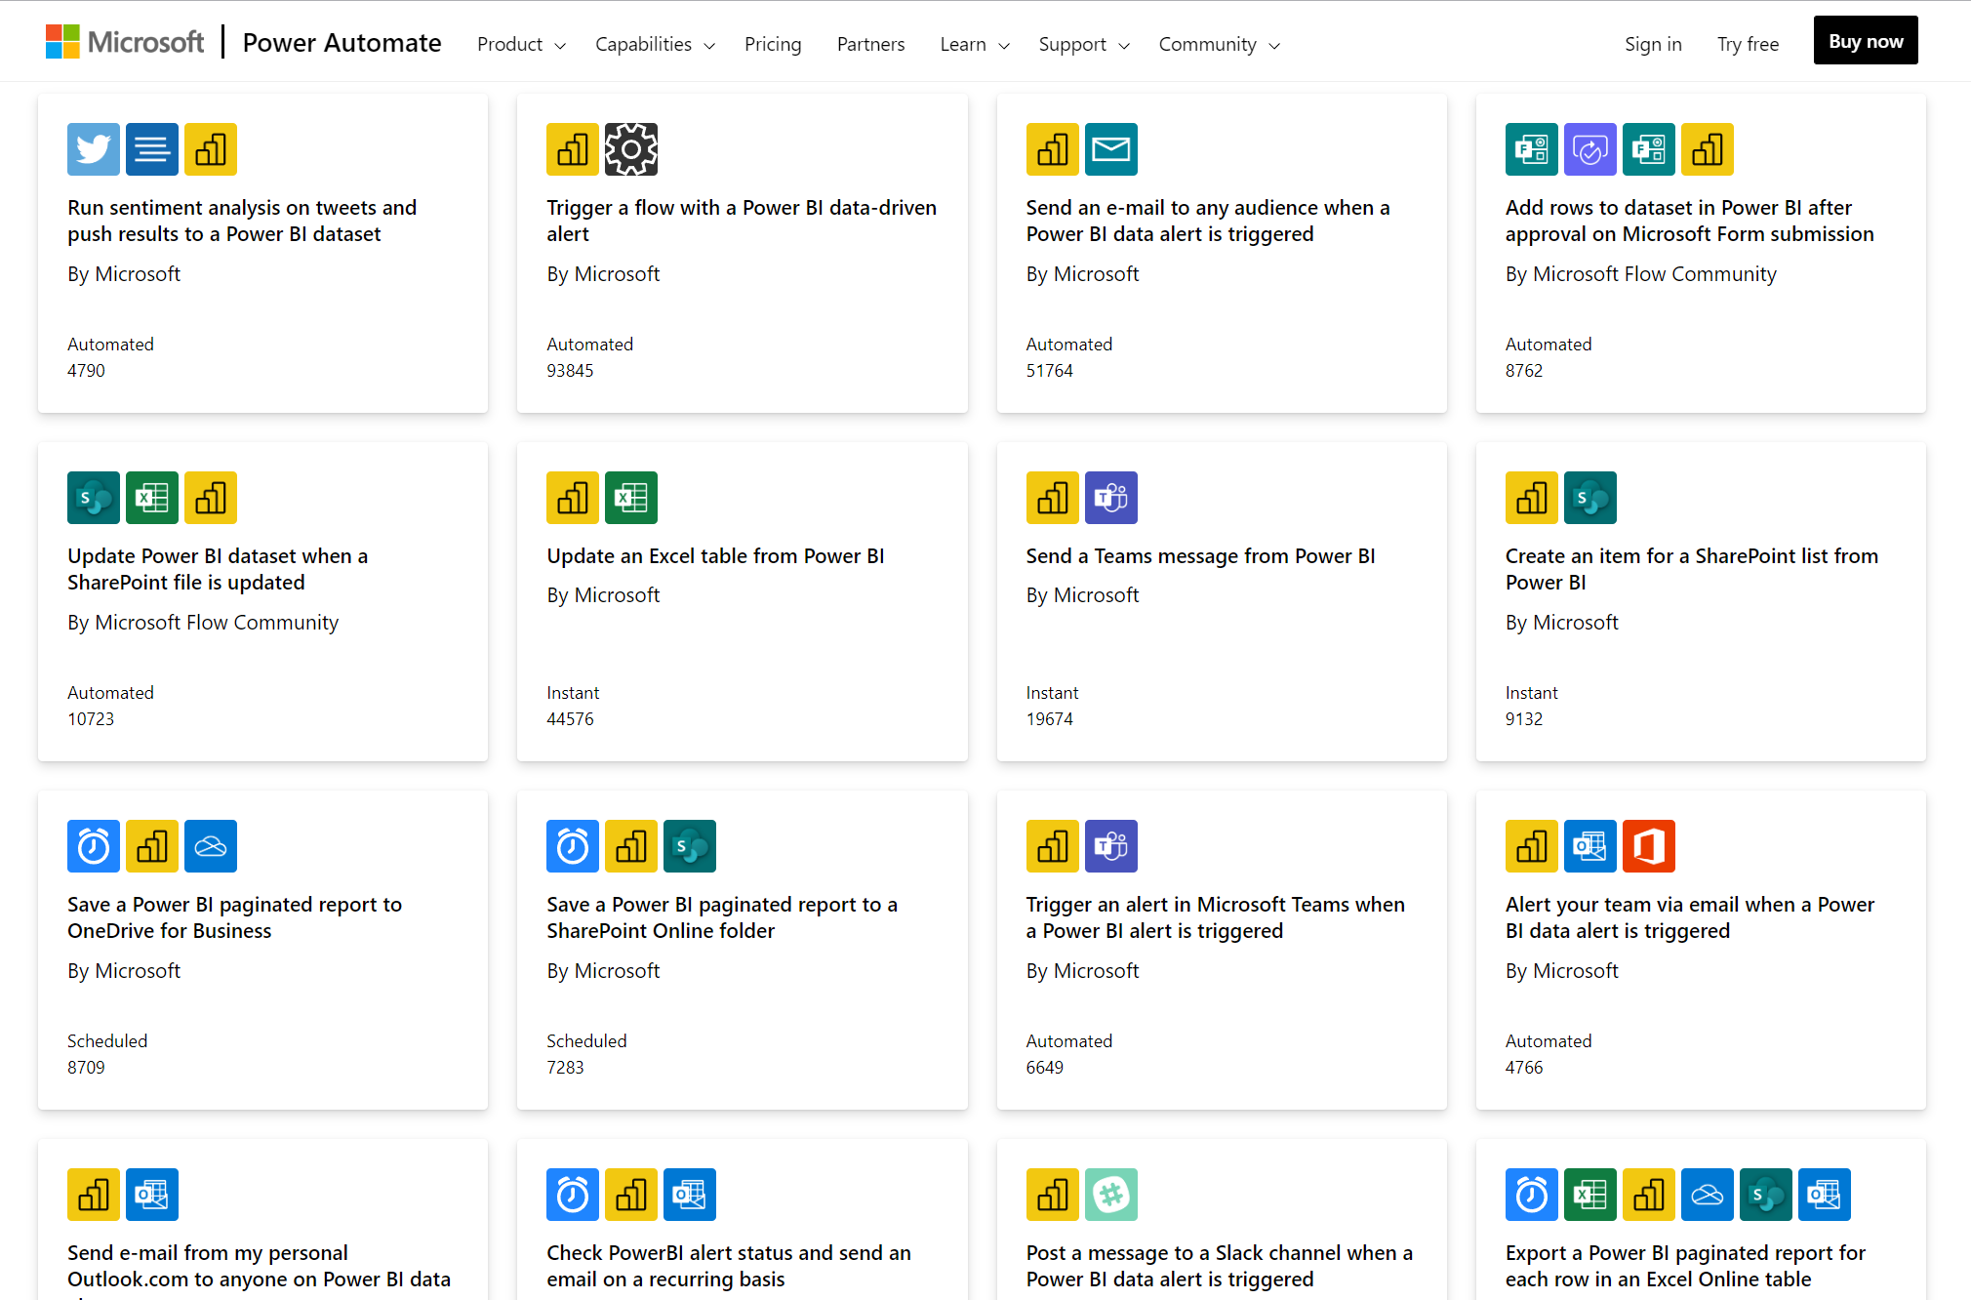
Connectors and Templates
Microsoft: Power Platform Templates

